Slide 1





SPOTIFY MUSIC RECOMMENDATION SYSTEM
Team :
Name : RubanTitus.S
Email Id : r20rubantitus2004@gmail.com
NM Id : aut22lme08 Guide: P.Raja(Master Trainer)
Disclaimer: The content is curated for educational purposes only.
Notes:
Slides: Prepare a short slide deck (10-12 slides) summarizing the project objectives, methodology, and key results.

Slide 2
Spotify Music Recommentation System
OUTLINE
Abstract of the Project
Problem Statement
Proposed Solution
System Architecture
Live Demo of The Project
Embedded Video of Project
Conclusion
Future Scope

Slide 3
Abstract
Spotify Music Recommentation System
Develop a music recommendation system that suggests songs to users based on their listening history and preferences. Improve user engagement and satisfaction with the Spotify platform. Increase music discovery and exploration among users. Users often struggle to find new music that aligns with their tastes and preferences.
Existing music recommendation systems may not fully capture user preferences or provide accurate suggestions. Spotify aims to improve its recommendation system to enhance user experience and competitiveness. content-based filtering works on item features. This filtering method recommends new items having similar characteristics as the user’s previous engagements.

Slide 4
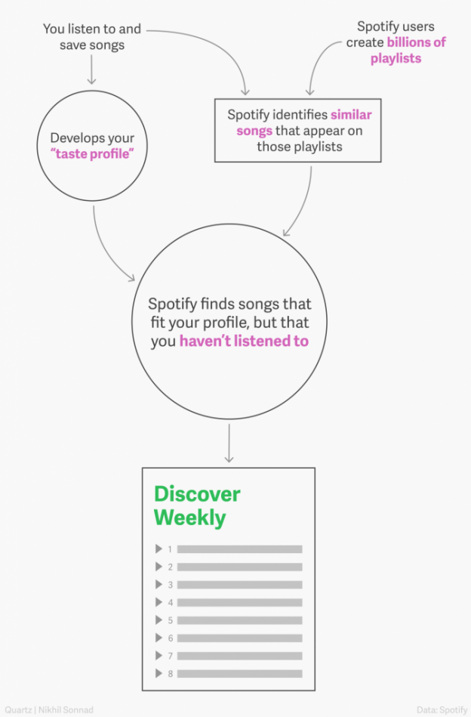
Problem Statement
Spotify Music Recommentation System
The Users often struggle to find new music that aligns with their tastes and preferences.
Existing music recommendation systems may not fully capture user preferences or provide accurate suggestions.
Spotify aims to improve its recommendation system to enhance user experience and competitiveness.

Slide 5
Proposed Solution
Spotify Music Recommentation System
Solution:The Project Involves utilization of k-means clustering for
music recommendation system.
Gather data on user listening history, preferences, and
interactions with the Spotify platform. This could include user
profiles, playlists, liked songs, skipped songs, etc.

Slide 6
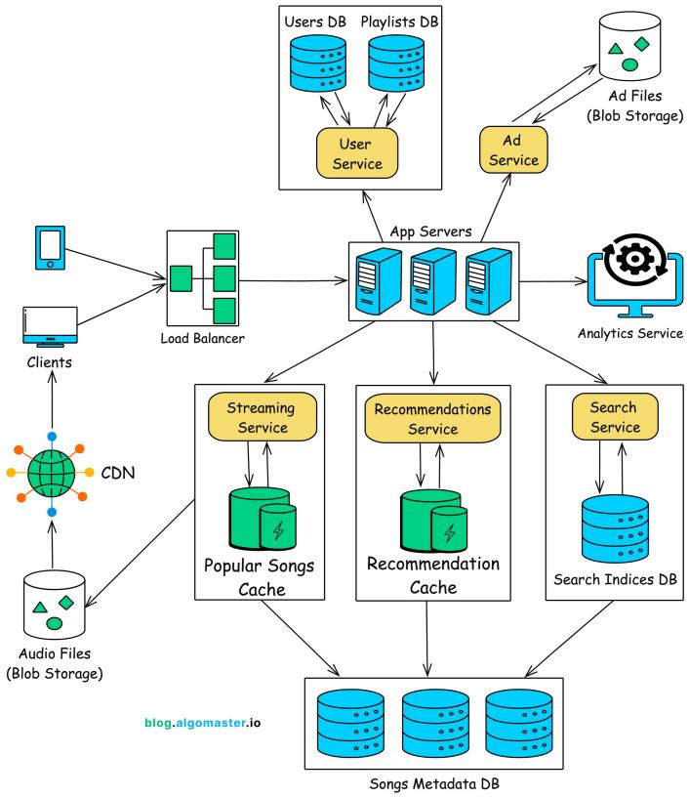
System Architecture
Spotify Music Recommentation System

Slide 7
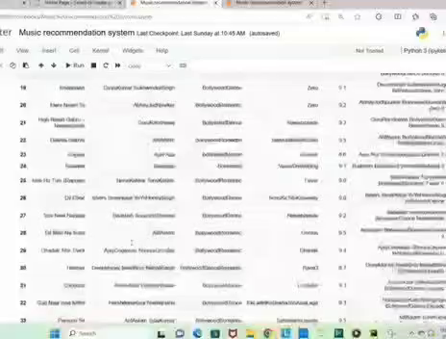
Live Demo Of The Project
Spotify Music Recommentation System

Slide 8
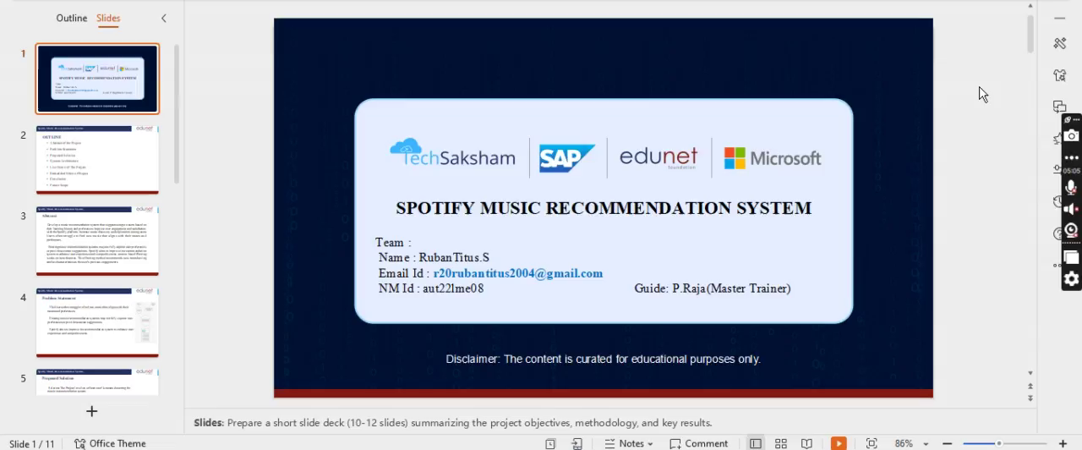
Spotify Music Recommentation System
Video of Project Demo

Slide 9
Conclusion
Spotify Music Recommentation System
In conclusion, The Spotify music recommendations system project has been a success, achieving its goals and objectives while providing a unique and personalized music recommendation experience for users.
The system has been designed to provide personalized music recommendations based on user behavior, preferences, and listening history, and has been shown to improve user engagement and satisfaction.

Slide 10
Future Scope
Spotify Music Recommentation System
Integrating with other services: Integrating the system with other services, such as social media, calendar, and location-based services.
Enhancing user feedback mechanisms: Enhancing user feedback mechanisms to improve the accuracy and relevance of music recommendations.
Exploring new techniques: Exploring new techniques, such as natural language processing and computer vision, to improve music recommendations.

Slide 11
Spotify Music Recommentation System
Thank you!
Notes:
thank you very much for joining this PPT, keep learning.

